Slide 1

Water, Sanitation & Hygiene Rotary Action Group
WASH-RAG
Vision, Operational Structure & Ambassadors
Eric Johnsen, MBA, MDiv
WASH-RAG Operations Chair
Water, Sanitation & Hygiene Rotary Action Group

Slide 2
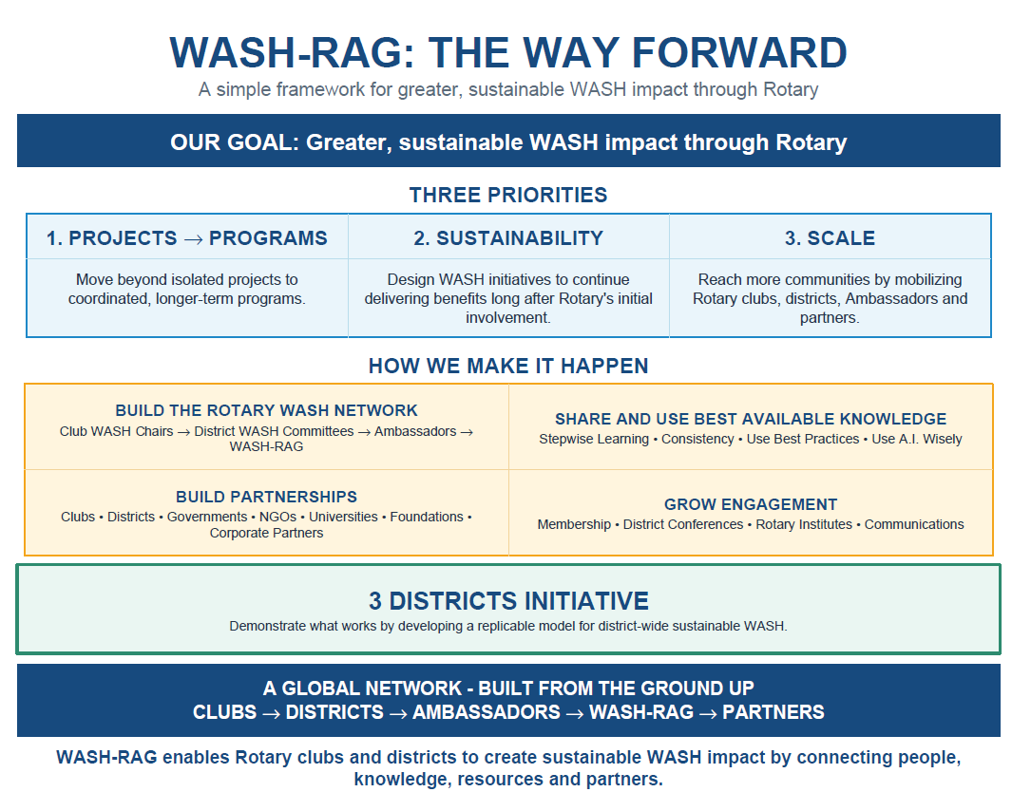

Slide 3
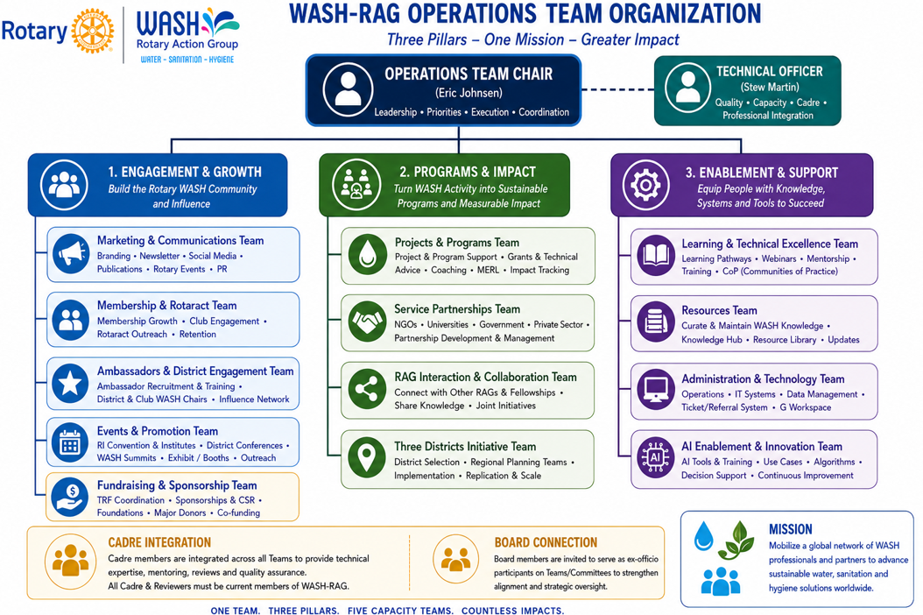
Treasurer
(Robert Hann)
Budget * Finances

Slide 4
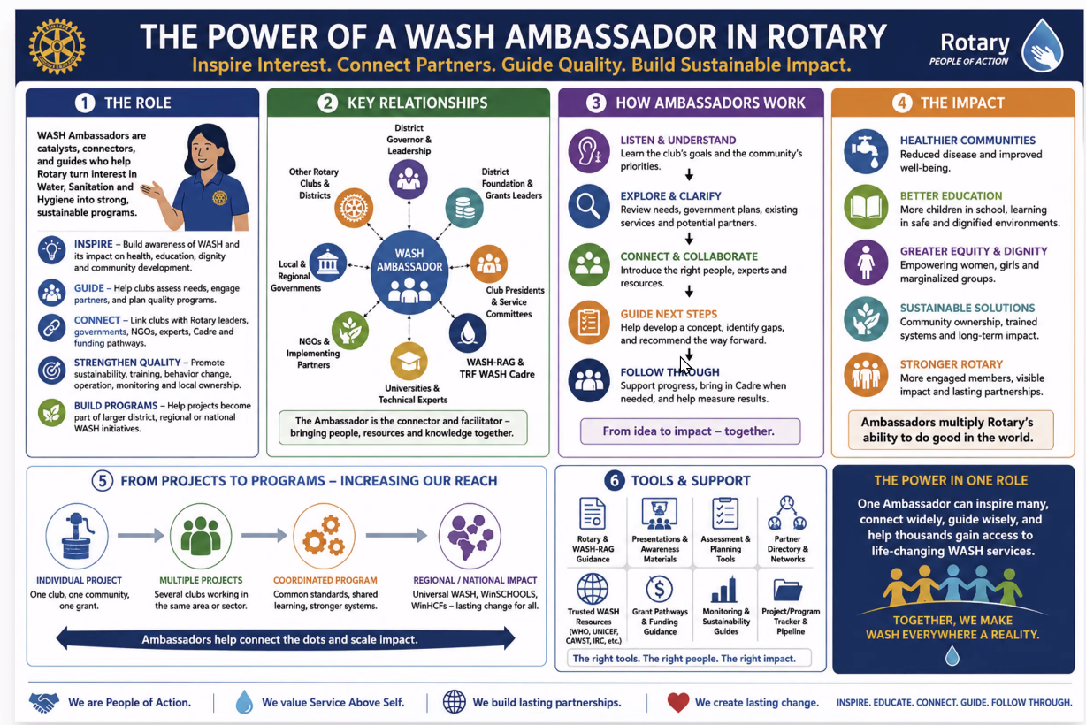

Slide 5
From Global Policy to Local Impact
1
2
3
4
5
Rotary
International
WASH-RAG
Board
Operations/
Ambassadors
District
WASH Leads
Club
WASH Leads
Sets global WASH priorities and resources
Governs strategy, approves programs, manages finances
Recruits, trains, deploys 160+ WASH Ambassadors
Coordinate multi-club WASH initiatives at the district level
Implement sustainable water, sanitation & hygiene projects
Educate clubs
Resource to clubs, connection to WASH-RAG
Collaborate and connect clubs, stakeholders, agencies, etc.
Facilitate & promote joint club projects
Funding resources
Regular education
WASH Summits
Engage & educate club members
New WASH-RAG memberships
Implement projects

Slide 6
Next Steps ….
EMAIL TO AUTHORIZE CONNECTION TO CLUBS
IDENTIFY DISTRICT WASH LEAD & AMBASSADOR
ENCOURAGE ENGAGEMENT FROM INTERESTED PARTICIPANTS
Vision: Mobilize a global network of WASH professionals and partners to advance sustainable water, sanitation and hygiene solutions worldwide.
WWW.WASHRAG.ORG

Slide 7


2027 Rotary International Convention Event
World Water, Sanitation & Hygiene Summit
📅 Date: Friday, June 25, 2027 ⏰ 9:00 am – 4:00 pm
Morning Education
Keynote presentations and inspiring speakers
Afternoon Break-Outs
Interactive discussions and Q&A with expert panels
Networking & Exchange
Connect with international leaders and exchange ideas
Collaborative Impact
Building partnerships for sustainable global WASH solutions
Local & Global Cuisine
Delightful culinary experiences throughout the summit
Evening Excursion
Optional dinner and authentic Flamenco cultural experience

