Slide 1

Ambassador Conversation:
Amanda Robertson
sustainable service delivery in
sub-Saharan Africa
May 5, 2026
Notes:
Welcome to Ambassador Conversation #32. Our goal is to create a sense of community among ambassadors. Just a group of friends meeting for coffee or a beer to chat and share ideas. While we start each month with a short presentation from an expert speaker, that is hopefully just a jumping off point for a conversation among friends.
Please put your name, club, district, and country in the chat so others on the call may know where you’re joining from.
Also, please put in the chat if you are going to be at the RI Convention in Taipei.
Just a couple of announcements

Slide 2
Next Ambassador Conversation
S.N. Srikanth
WASH Ambassador
WASH-RAG Board of Directors
Tuesday, June 2nd
10AM Eastern (UTC-14:00)
Notes:
Next conversation is June 2, 10AM Eastern Daylight Time/ 14:00 UTC
Our speaker is our very own S.N.Srikanth, Director of WASH-RAG and a WASHRAG Ambassador
with extensive experience in behaviour change for sanitation and other social causes.
• Former TRF Cadre Member for WASH
• Advisor to the Rotary Foundation’s WASH Global Grant Guidelines Review Team
• Recipient of the “International Service Award for a Polio Free World” from RI.

Slide 3
Ambassador Orientation
Lead by:
Ambassador Dilip Mirchandan
Monday, May 26, 2026
10:00 – 11:00am EDT
(14:00 – 15:00 UTC)
Notes:
This will be an opportunity for Ambassadors to meet and greet each, a chance to recruit new ambassadors, and for anyone interested to learn about WASHRAG and how they might get involved in water projects around the world.

Slide 4
Ambassador Meet & Greet
Monday, June 15, 15:15 - 16:15
Room 504A at Tainex-1
Notes:
This will be an opportunity for Ambassadors to meet and greet each, a chance to recruit new ambassadors, and for anyone interested to learn about WASHRAG and how they might get involved in water projects around the world.

Slide 5

SATURDAY, June 13, 2026, 8:00 – Noon
Link in chat
Notes:
Gary Huang, Past President, Rotary International
Faiz Kidwai, Past RI Director, SMART Villages project, Sindh Province, Pakistan
Brian Ashworth, Honorary CEO, Disaster Aid Australia
Wade Nomura, Ops Team Chair, WASH-RAG, Reforesting the Denuded Watershed in Guatemala
Steve Werner, Chair Ambassadors Committee, WASH-RAG, Effective Usage of Our Ambassadors
Steve Bender, Environmental Sustainability Rotary Action Group
Iryna Odyntsova, PP RC Dnipro Novyii, Ukraine, Ukraine Water

Slide 6

BREW Bash
Tuesday, June 16, 2026
6:00 – 10:00 PM
www.rotarybrew.org
Notes:
Rotary BREW Fellowship event in Taipei on the Tuesday night of the convention. Tickets on sale now. Proceeds from this event are donated to WASHRAG, last year it was $5,000.
Now Nancy Gilbert has an announcement about IRCWASH short courses for Ambassadors starting next week.
Then we’ll turn it over to Steve.

Slide 7
WASH Ambassador Conversation
Tuesday, 5 May 2026
Amanda Robertson

Slide 8
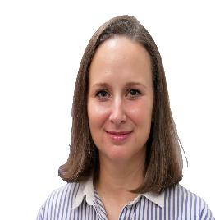
Speaker: Amanda Robertson
Amanda Robertson is a WASH specialist focused on sustainable service delivery in sub-Saharan Africa for the past 20 years.
After graduating with a Master’s degree in African Studies from Yale University, Amanda worked for Heifer International, The Rotary Foundation, and USAID, managing people and investments in WASH, water resource management, water for agriculture, energy, financing, and governance.
She was the inaugural Water Warrior awardee at USAID for her dedication to leadership in the sector and the recipient of several Meritorious Honor awards from embassies across the continent. She has happily called Nairobi home since 2019.

Slide 9
Agenda
Sustainable development goal 6
Key wash resource sites
Technical resources
Resource groups
The future of foreign assistance
Question and answer

Slide 10
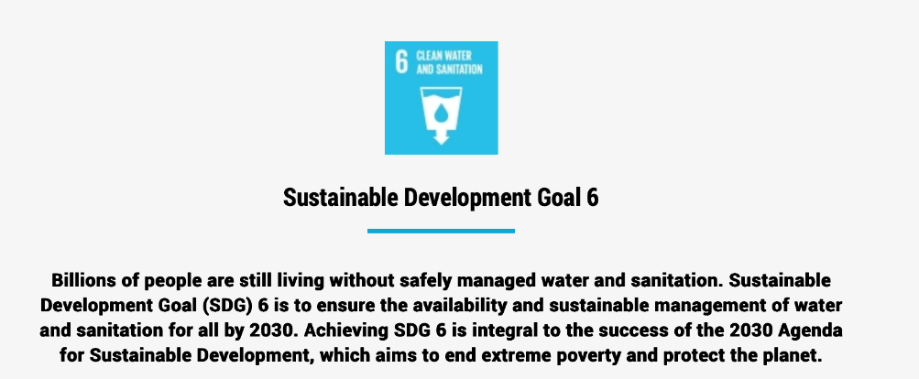
Sustainable development goal 6

Slide 11
Key wash resource sites
UN Water: Coordination across UN agencies, global initiatives, policy briefs, SDG resources
UNICEF: Child-focused WASH programming, data, field guidance, programmatic tools
World Health Organization (WHO): Global guidance, standards, health links, normative guidance and technical reports
World Bank: Financing, project databases, policy research, country programs
Rural Water Supply Network (RWSN): Rural WASH practice, manuals, technical notes and knowledge products
Global wash cluster: humanitarian assistance coordination and resources

Slide 12
Technical resources
WHO/UNICEF Joint Monitoring Programme for Water Supply, Sanitation and Hygiene (JMP)
UN-Water Global Analysis and Assessment of Sanitation and Drinking-Water (GLAAS)
Implementation of the water and sanitation for health facility improvement tool (WASH FIT)
The Three Star Approach for WASH in Schools: Field Guide
World Bank Water Forward
RWSN Technical webinar series
IRC WASH Systems leadership

Slide 13
Resource Groups
Circuit Riding Community of Practice - Practical Guidance Working Group
RWSN membership
International water association
Engineers without borders
Linkedin

Slide 14
The future of foreign assistance
Us foreign assistance
Bilateral and multilateral
Foundations
Private sector
impact investors

Slide 15
Question & answer

