Slide 1


State of Global WASH Services
“Incremental Progress, Deepening Crisis & Inequalities, More Progress is Possible”
Najib Bateganya, PhD
World Water Day 2026
Theme - Water and gender: Where water flows,
equality grows

Slide 2
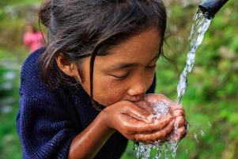
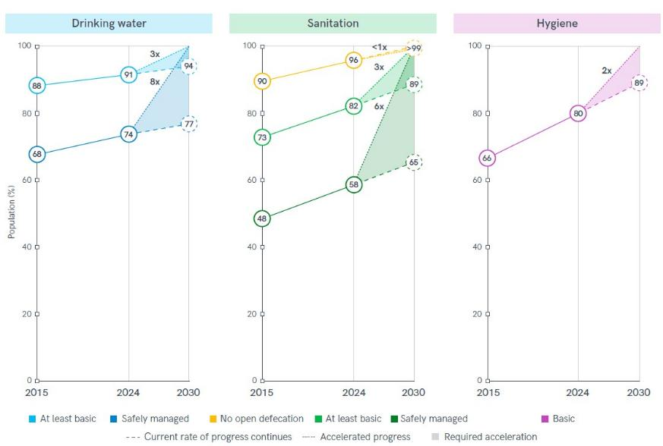
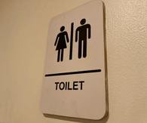
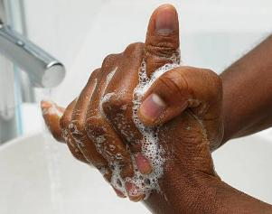
Global Access to WASH Services JMP, 2024 (UNICEF/WHO)
1 March 2026

Slide 3
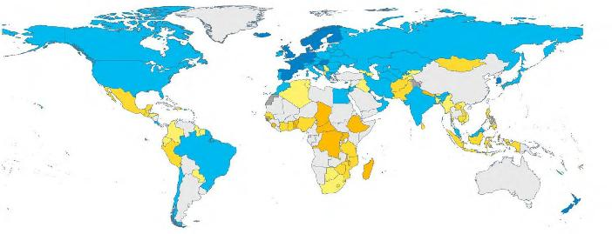
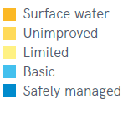
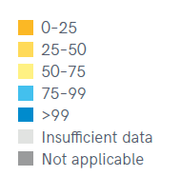
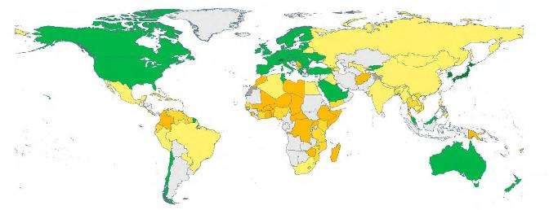
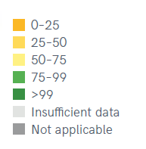
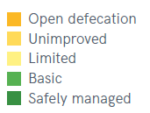
Global WASH Service Inequalities JMP, 2024 (UNICEF/WHO)
Population (%) using safely managed drinking water services
Population (%) using safely managed sanitation services
1 March 2026

Slide 4
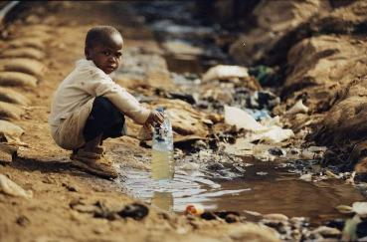
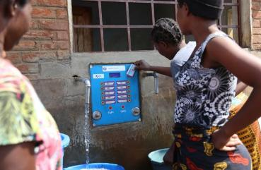
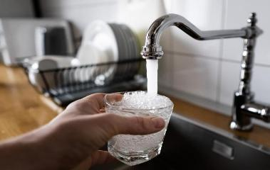
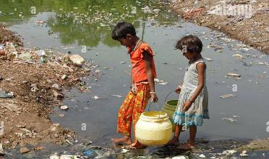
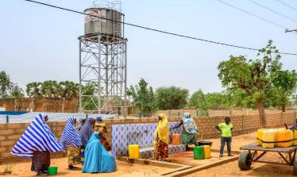
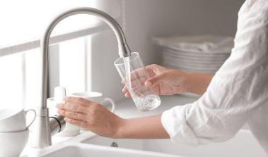
Global WASH Service Inequalities JMP, 2024 (UNICEF/WHO)
Access to drinking water with varying standards and quality across the world
1 March 2026
Foundation Master Template (TO EDIT THIS TEXT: select Header & Footer on Insert tab)

Slide 5
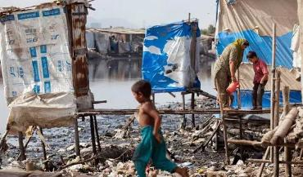
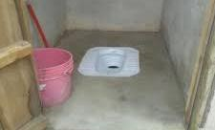
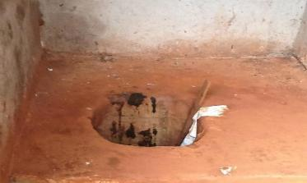
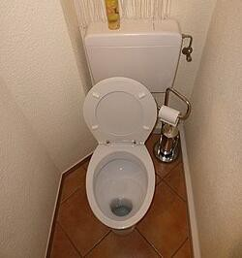
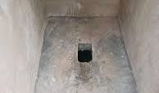

Global WASH Service Inequalities JMP, 2024 (UNICEF/WHO)
Access to sanitation facilities with varying standards and quality across the world
1 March 2026
Foundation Master Template (TO EDIT THIS TEXT: select Header & Footer on Insert tab)

Slide 6
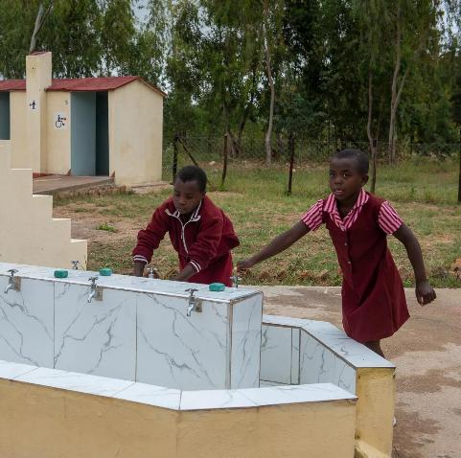
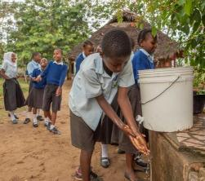
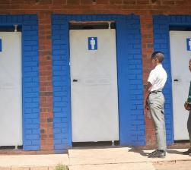
WASH in Schools
Inequalities push girls at the extreme survival edge – education outcomes and social- economic opportunities are grossly compromised
“Schools are where WASH becomes gender
equality—or gender inequality—at scale.
In 2023, 447 million children still lacked basic drinking water at school, 427 million lacked basic sanitation, and 646 million lacked basic hygiene.
222 million children had no sanitation service at school, with more than half in just four countries—India, Nigeria, Ethiopia, and Pakistan.
For girls, the standard can’t stop at ‘a toilet exists.’ Menstrual health requires privacy, safety, bins, and disposal.

Slide 7
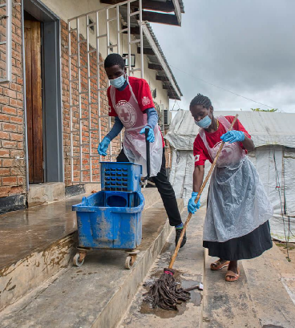
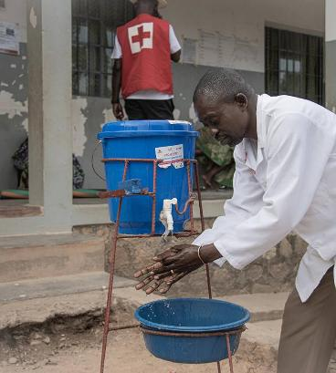
WASH Services in Health Facilities
A critical, non-negotiable foundation for infection prevention, quality care, and patient safety, preventing up to 70% of infections
When WASH fails in health care facilities, the consequences are immediate: infection risks rise, quality of care falls, and trust in the health system erodes.
In 2023, in fragile contexts, 37% of facilities had no basic water service and 54% lacked basic hygiene.
And this isn’t a small population: the report estimates 2 billion people lived in fragile contexts in 2023, with huge numbers lacking facility-level sanitation, waste management, cleaning, hygiene, and water.
This is where a systems lens matters: it’s not just installing a tap or a toilet —it’s ensuring supply chains, staffing, budgets, supervision, and accountability.

Slide 8
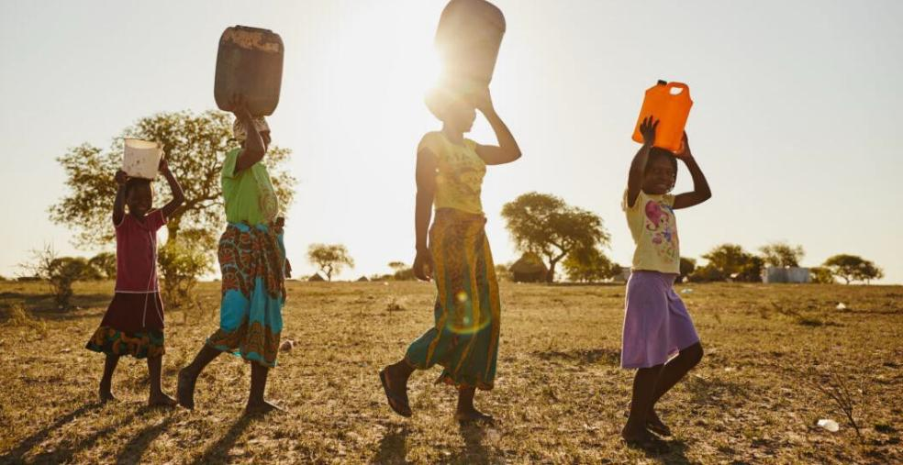
Why progress is uneven: systems constraints + water stress realities
WASH failures cluster where systems capacity is lowest; Climate and water stress amplify service unreliability and costs; Better monitoring and governance enable smarter, fairer investments
1 March 2026
©Gates Foundation
8

Slide 9
Promising pathways: what works, where, and how to scale
Target the fastest-growing gaps: urban, low-income, fragile contexts
Shift from “build” to “operate, maintain, regulate, improve.”;
Scale inclusive WASH services to reduce inequalities
Accelerating Equitable & Sustainable WASH
Systems & Governance
Accountable service authorities with gender-responsive governance, policies, regulations and transparent
performance reporting
Financing & Incentives
Targeted financing and performance-linked incentives sustaining reliable, inclusive and equitable WASH services
Service Delivery Models
Professionalized urban & rural WASH services including community and private sector participation
Data, Technology & Innovation
Equity-focused data, technologies, and innovations driving quality, reliability, climate resilience
Gender-Transformative WASH
Gender-transformative WASH ensuring safety, menstrual health, and services in schools and health facilities
1 March 2026
©Gates Foundation

