Slide 1









Rotary’s Global Water, Sanitation, and Hygiene Strategy 2035

Slide 2
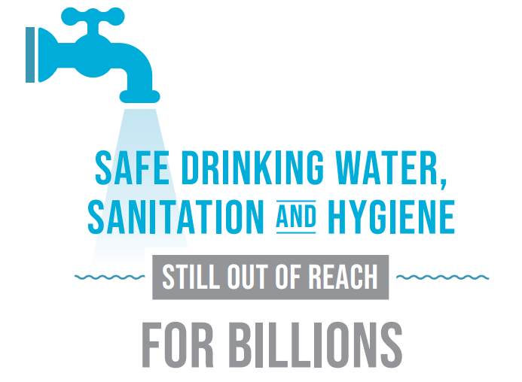
Notes:
Rotary is taking action to improve access to safe water, sanitation, and hygiene (WASH) – but the scale of the crisis demands more than business as usual.

Slide 3
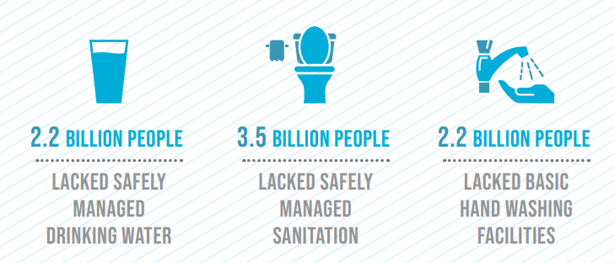
Notes:
3.5 billion people still lack access to safely managed sanitation
2.2 billion lack access to clean drinking water
4 billion people experience water scarcity for at least 1 month each year due to the mismanagement of our freshwater resources and climate change

Slide 4
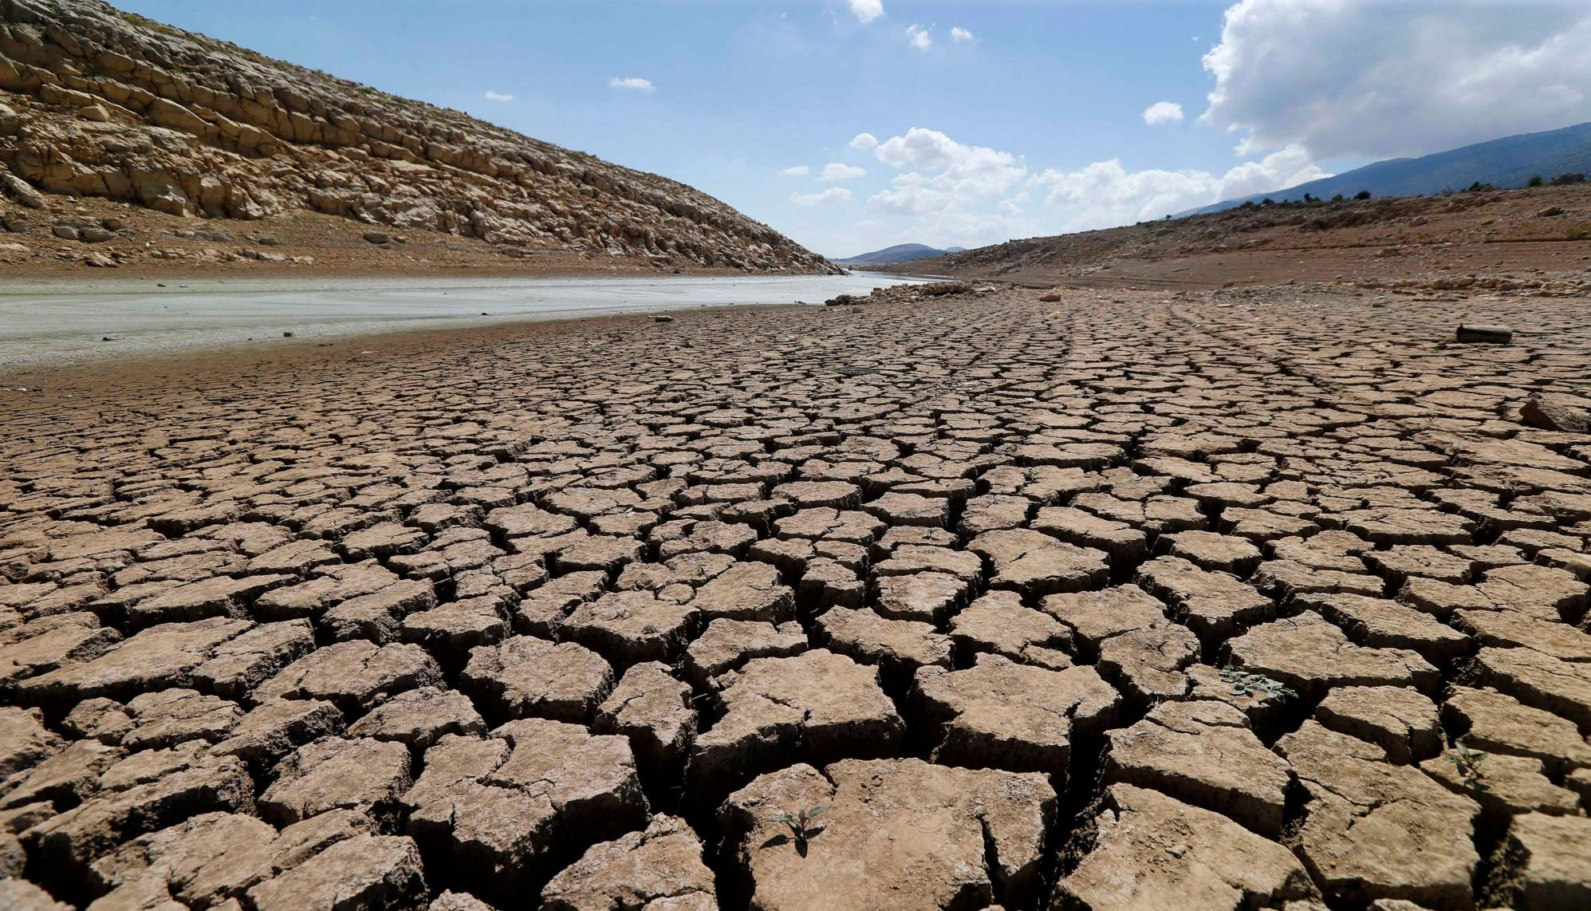
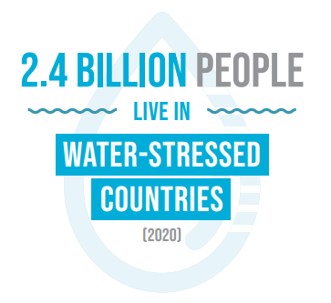

Slide 5

WHY DOES ROTARY NEED A GLOBAL WASH STRATEGY?

Slide 6

Notes:
(Answer to question in previous slide)

Slide 7
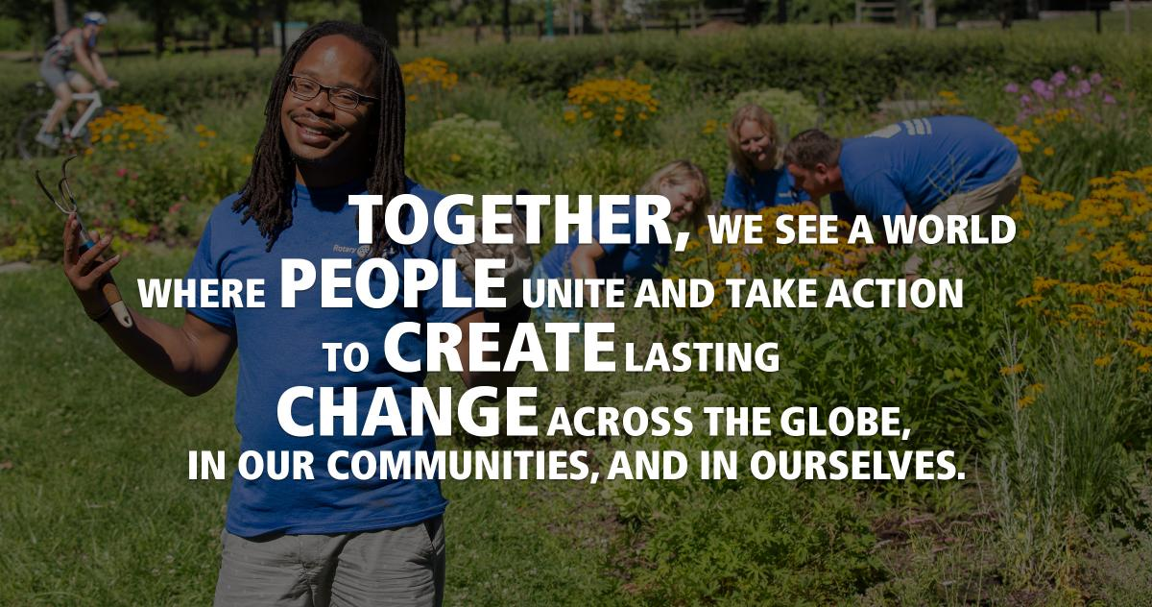

Slide 8
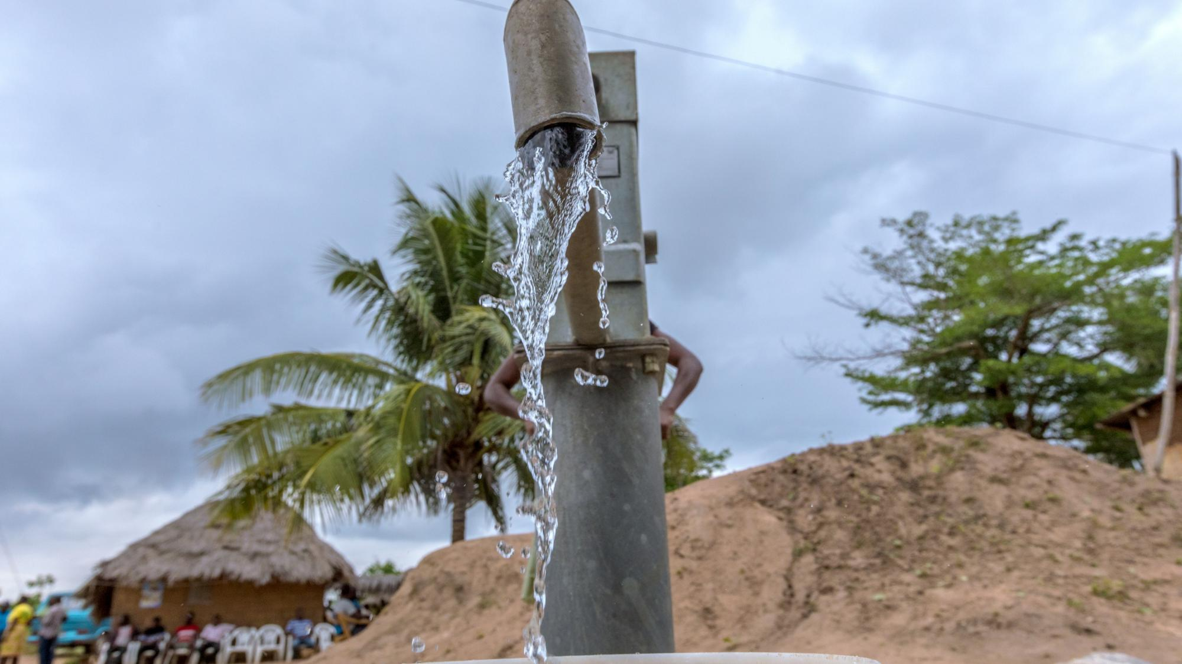

Rotary envisions a water-secure world, where local governments, service providers, and civil society have the commitment, accountability, skills and financing to provide sustainable, climate-resilient, and safe WASH services for all.
Water, Sanitation, and Hygiene Vision
Notes:
Rotary’s Global WASH Strategy, is a call to action for members, developed by members aligning with UN Sustainable Development Goal 6: Ensure Access to water and sanitation for all.
Our Vision: “Rotary envisions a water-secure world, where local governments, service providers, and civil society have the commitment, accountability, skills and financing to provide sustainable, climate-resilient, and safe WASH services for all.”

Slide 9


FOCUS ROTARY RESOURCES AND ACTIVITY Improve access to sustainable, climate-resilient WASH in schools and healthcare facilities
Objective 1A
Notes:
The first call to action within Rotary’s WASH Strategy is to FOCUS OUR RESOURCES AND ACTIVITIES. The strategy describes two paths that members can rally behind, depending on their level of commitment to WASH and experience in WASH programing.
Within the next year, Rotary will launch its first global WASH campaign to achieve universal access to WASH in schools and healthcare facilities by 2030. This will be an opportunity for Rotary members to come together, as they did for Polio, to meet defined global targets for WASH in schools and healthcare facilities.

Slide 10
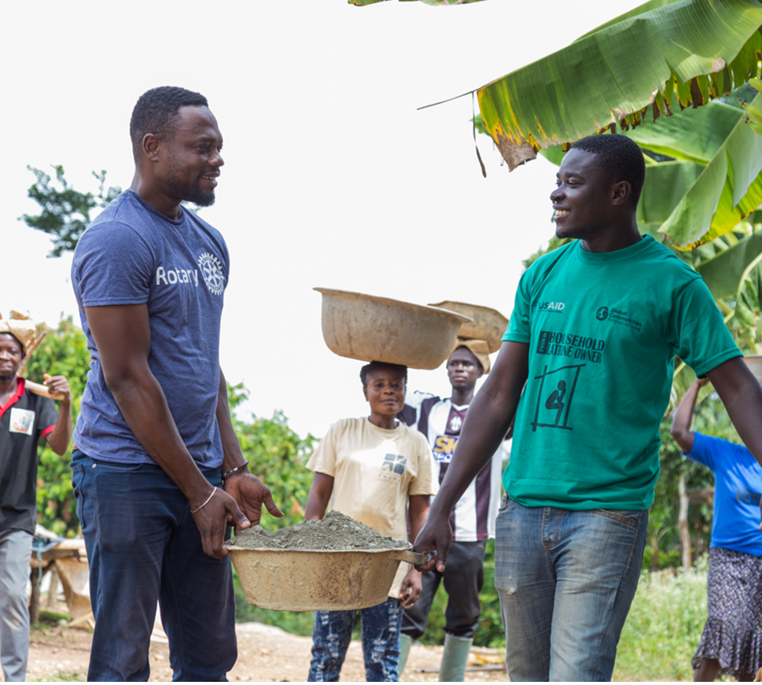
FOCUS ROTARY RESOURCES AND ACTIVITY Align Rotary WASH activity via coordinated regional and national planning
Objective 1B
Notes:
For highly active rotary countries, Rotary’s Global WASH Strategy incentivizes clubs to develop regional plans and implement a WASH program driven by a common vision. This challenges each rotary country to coordinate and concentrate club activity in specific geographic districts/communes/states, monitor progress, and build local leadership for measurable impact. Those that rise to the challenge will be recognized as Rotary Priority WASH Countries, receiving global visibility, advanced technical support and coaching, access to Rotary’s Strategic Partnerships, and preparatory support to apply for programs of scale.
In certain parts of the world, Rotary members are already shifting single-club drive projects, to multi-club and even multi-district driven programs, united by a common vision.
In Honduras, clubs are coming together to ensure climate-resilient water services are accessible and available to all in Western Honduras. We see this happening in Haiti (HANWASH), Uganda, Ghana, Honduras, and Nepal.

Slide 11
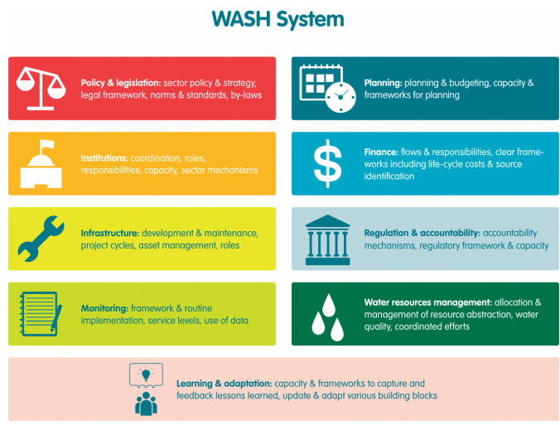
STRENGTHEN WASH SYSTEMS TO ENSURE SUSTAINABLE SERVICES
Objective 2
ircwash.org
Notes:
The second call to action challenges us to strengthen the systems that sustain WASH services. This means working alongside the local institutions responsible for WASH, improving coordination among actors, and designing projects that implement national policies at the local level. When our efforts feed into local monitoring systems, use existing supply chains, and support long-term change driven by local service providers and governments, Rotary’s impact becomes part of a lasting solution.

Slide 12
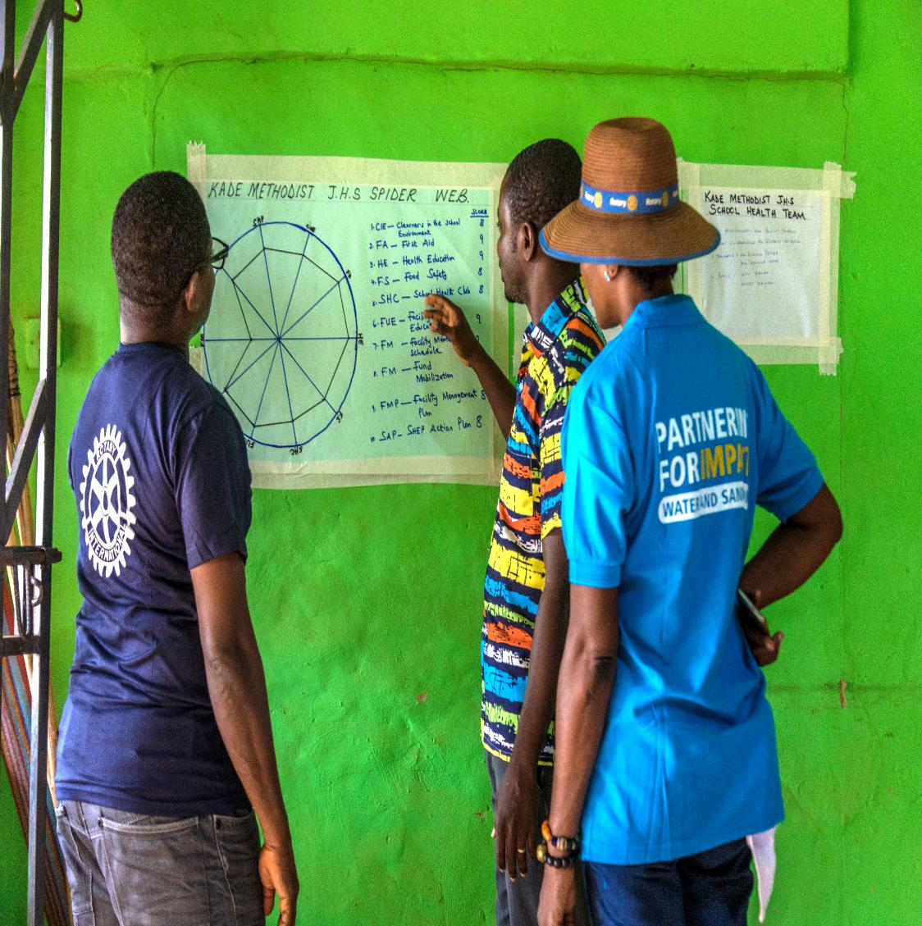
PRIORITIZE WASH ADVOCACY WITHIN ROTARY SERVICE PROJECTS
Objective 3
Notes:
The third call to action ignites Rotary’s hidden superpower — advocacy. Rotary members are not just project implementers; we are trusted voices in our communities. By using our influence to elevate WASH priorities with local and national leaders, we can help unlock funding, amplify the voices of the community to duty bearers, shape policy, and ensure communities have the resources and accountability they need to sustain services long after a project ends.

Slide 13

CULTIVATE STRATEGIC PARTNERSHIPS FOR COLLECTCIVE ACTION AND GREATER IMPACT
Objective 4
Notes:
The fourth call to action is to develop strategic partnerships for collective action. Rotary can’t do this alone — and we don’t have to. By aligning with governments, NGOs, and donors behind a shared country vision, we can amplify our impact, fill gaps in the system, and ensure our work fits into something bigger than any one project.

Slide 14
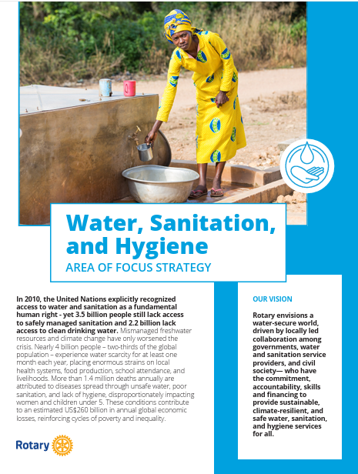
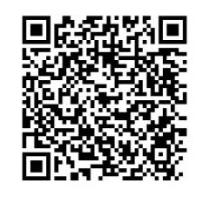
Notes:
Read more about Rotary’s Global WASH Strategy at rotary.org or scan the QR code on the screen for quick access (available in all 7 official rotary languages).
How will your club and district take action to align with the new strategy? What incentives are needed to gain engagement and early adoption?

Slide 15











QUESTIONS?
Erica Gwynn, Area of Focus Manager, WASH
erica.gwynn@rotary.org

Slide 16
CONNECT TO YOUR LOCAL ROTARY WASH NETWORK AND!
Photo: N. Clayton
THANK YOU! ERICA.GWYNN@ROTARY.ORG

