Slide 1


2025 People of WASH Photograph & Video Competition Competition ran from December 1, 2024, to April 30, 2025
51 Photographs Submitted
7 Videos Submitted
Judged by three members of the International Fellowship of Rotarian Photographers
Madhumita Bishnu
Lara Stefansdottir Jatin Patel
2025 People of WASH
Photograph and Video Competition

Slide 2
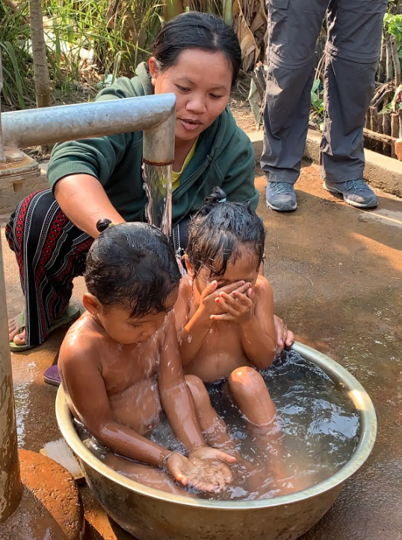
PHOTOGRAPHS
FIRST - $300
May Yoneyama O’Brien
Washington, DC
Photo
Pursat, Cambodia
2025 People of WASH
Photograph and Video Competition

Slide 3
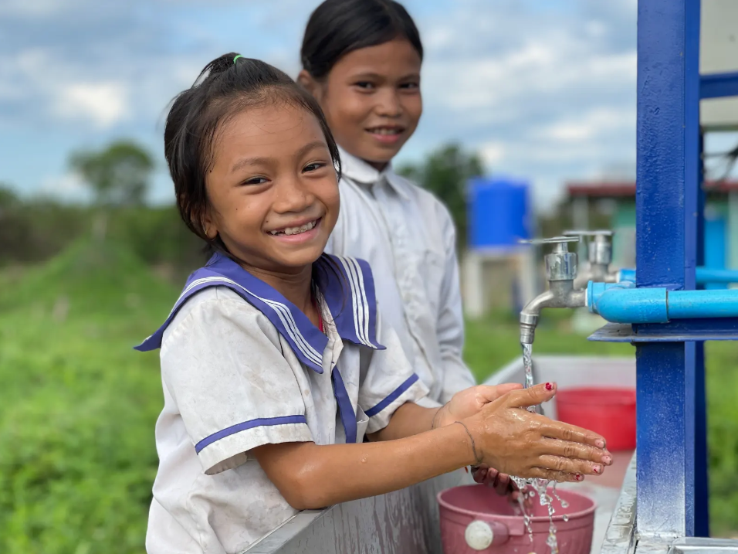
PHOTOGRAPHS
SECOND - $150
Hang Hybunna
Stung Treng, Cambodia
Photo
Stung Treng, Cambodia
2025 People of WASH
Photograph and Video Competition

Slide 4
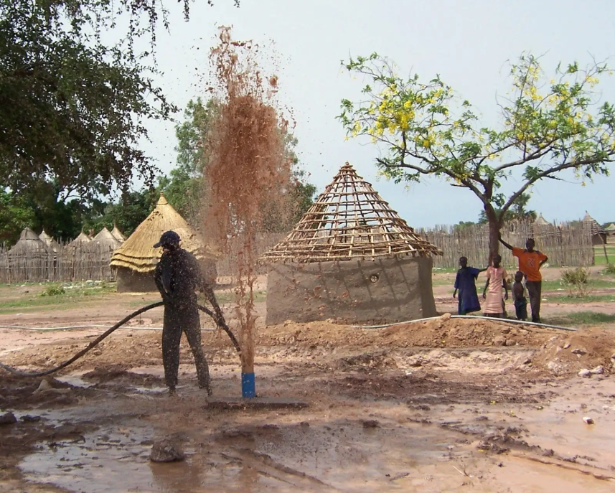
PHOTOGRAPHS
THIRD - $75
Patty Hall
White Bear Lake, MN
Photo
Sudan
2025 People of WASH
Photograph and Video Competition

Slide 5
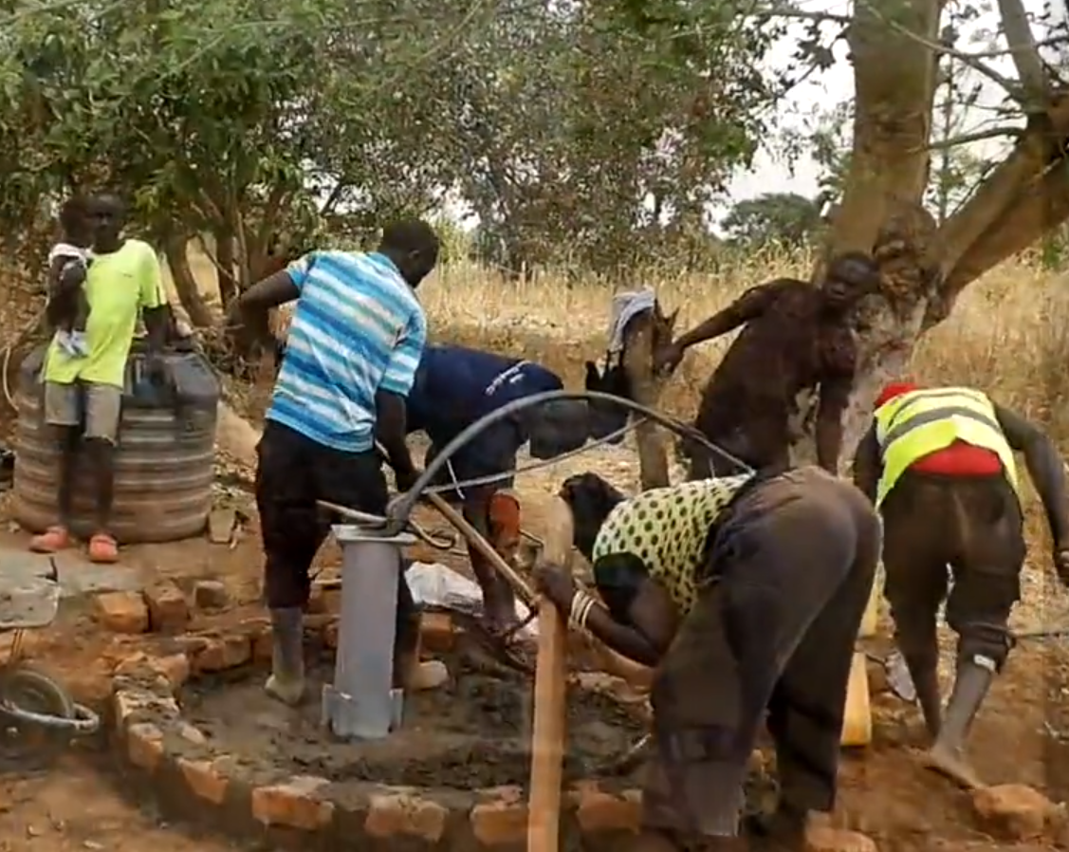
Video
First - $600
Chris Roesel
Yumbe, Uganda https://vimeo.com/1080876340
Photo
Chana and Nakivale, Uganda
2025 People of WASH
Photograph and Video Competition

Slide 6
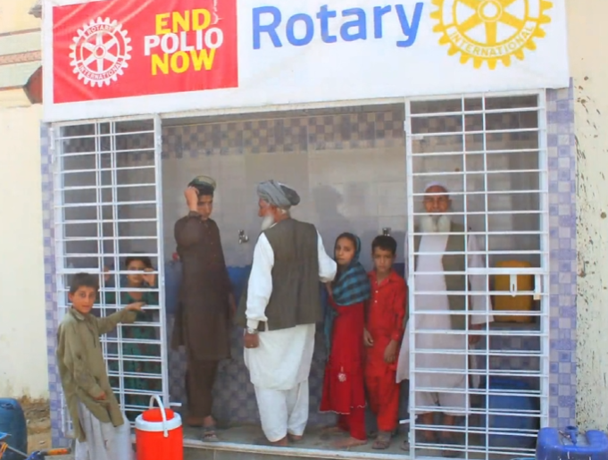
Video
Secord - $300
Asher Ali
Karachi, Pakistan https://vimeo.com/1080876090
Photo
Mubarak, Pakistan
2025 People of WASH
Photograph and Video Competition

Slide 7
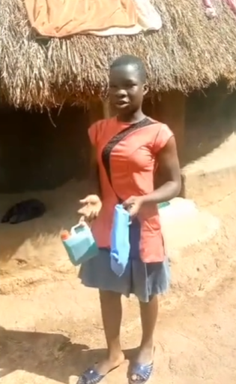
Video
Third - $150
Gertrude Noden
Ithaca, NY https://vimeo.com/1080978141
Photo
Gulu, Uganda
2025 People of WASH
Photograph and Video Competition

